Slide 1
Value Addition Courses VAC
UGCF-2024

Slide 2
About VACs
31 VAC Courses Approved by the University
Each VAC Course is of 2 Credits
4 VACs to be studied in total
1 VAC in each of the first four semesters
Internal Assessment: 25%
End Semester Theory Exam: 25% (for Credit distribution 1+1)
Practical: 50% (for Credit distribution 1+1)
Practical: 100% (for Credit distribution 0+2)

Slide 3
List of 31 Approved VACs
S.No. | Title | Credits | Credit Distribution | Offered by College
1 | Ayurveda and Nutrition | 2 | 1L + 1P | Yes
2 | Constitutional Values and Fundamental Duties | 2 | 1L + 1P | Yes
3 | Culture and Communication | 2 | 1L + 1P | Yes
4 | Digital Empowerment | 2 | 2P | Yes
5 | Emotional Intelligence | 2 | 1L + 1P | Yes
6 | Ethics and Culture | 2 | 1L + 1P | Yes
7 | Ethics and Values in Ancient Indian Traditions | 2 | 1L + 1P | No

Slide 4
List of 31 Approved VACs
S.No. | Title | Credits | Credit Distribution | Offered by College
8 | Financial Literacy | 2 | 1L + 1P | Yes
9 | Fit India | 2 | 2P | No
10 | Gandhi and Education | 2 | 1L + 1P | Yes
11 | Ecology and Literature | 2 | 1L + 1P | No
12 | National Cadet Corps-I | 2 | 1L + 1P | No
13 | Panchkosha: Holistic Development of Personality | 2 | 1L + 1P | No
14 | Reading Indian Fiction in English | 2 | 1L + 1P | No

Slide 5
List of 31 Approved VACs
S.No. | Title | Credits | Credit Distribution | Offered by College
15 | Science and Society | 2 | 1L + 1P | Yes
16 | Social and Emotional Learning | 2 | 1L + 1P | No
17 | Sports for Life | 2 | 2P | Yes
18 | Swachh Bharat | 2 | 1L + 1P | Yes
19 | The Art of Being Happy | 2 | 1L + 1P | Yes
20 | Vedic Mathematics-I | 2 | 1L + 1P | Yes
21 | Yoga: Philosophy and Practice | 2 | 1L + 1P | Yes

Slide 6
List of 31 Approved VACs
S.No. | Title | Credits | Credit Distribution | Offered by College
22 | भारतीय भक्ति : परंपरा और मानव मूल्य | 2 | 1L + 1P | No
23 | साहित्य, संस्कृति और सिनेमा | 2 | 1L + 1P | No
24 | सृजनात्मक लेख के आयाम | 2 | 1L + 1P | No
25 | Vedic Mathematics-II | 2 | 1L + 1P | No
26 | Vedic Mathematics-III | 2 | 1L + 1P | No
27 | National Cadet Corps-II | 2 | 1L + 1P | No
28 | National Cadet Corps-III | 2 | 1L + 1P | No

Slide 7
List of 31 Approved VACs
S.No. | Title | Credits | Credit Distribution | Offered by College
29 | Indigeous Sports | 2 | 1L + 1P | No
30 | Sports - Diversity and lnclusivity | 2 | 1L + 1P | No
31 | Tribes of India | 2 | 1L + 1P | No

Slide 8
Google Form
Our college is offering 14 Value Addition Courses for 1st semester 2024-25.
The Google option form for VAC-1 papers is available on college website.
The Link for the same shall be activated from 5 pm on 6th September 2024.
Please fill the form only once. Multiple submission of form shall exclude you from the allotment process.
You have to select one and only one paper for each of the preferences, otherwise you won't be able to submit the form.
The allotment shall be done by the college on FIRST COME FIRST SERVED basis as per student preferences as best as possible and subject to availability of seats in a particular course.

Slide 9
Google Form
Mandatory Fields
Email Id (registered on CUET form)
Name
Father’s Name
Date of Birth
Email Id filled in the CUET Form
Mobile Number
CUET Application Form Number
Program registered in the college

Slide 10
Preference Grid
 | Ayurveda & Nutrition | Constitutional Values & Fund. Duties | Culture & Communication | Digital Empowerment | Emotional Intelligence | Ethics & Culture | Financial Literacy | Gandhi and Education | Science & Society | Sports for Life-1 | Swachh Bharat | The Art of Being Happy | Vedic Math-I | Yoga: Philosophy & Practice
Pref 1 | n | n | n | n | n | n | n | n | n | n | n | n | n | n
Pref 2 | n | n | n | n | n | n | n | n | n | n | n | n | n | n
Pref 3 | n | n | n | n | n | n | n | n | n | n | n | n | n | n
Pref 4 | n | n | n | n | n | n | n | n | n | n | n | n | n | n
Pref 5 | n | n | n | n | n | n | n | n | n | n | n | n | n | n
Pref 6 | n | n | n | n | n | n | n | n | n | n | n | n | n | n
Pref 7 | n | n | n | n | n | n | n | n | n | n | n | n | n | n
Pref 8 | n | n | n | n | n | n | n | n | n | n | n | n | n | n
Pref 9 | n | n | n | n | n | n | n | n | n | n | n | n | n | n
Pref 10 | n | n | n | n | n | n | n | n | n | n | n | n | n | n
Pref 11 | n | n | n | n | n | n | n | n | n | n | n | n | n | n
Pref 12 | n | n | n | n | n | n | n | n | n | n | n | n | n | n
Pref 13 | n | n | n | n | n | n | n | n | n | n | n | n | n | n
Pref 14 | n | n | n | n | n | n | n | n | n | n | n | n | n | n

Slide 11
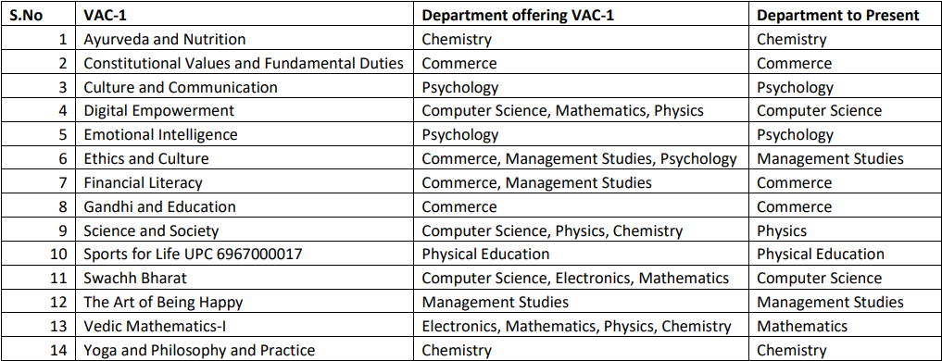
VAC -1 paper-wise Presentation:

